Slide 1
PRESIDENCY UNIVERISTY, BENGALURU, School of Engineering
Computer Organization and Architecture
CSE 2009
Module-4: Part A- Basic processing Unit (BPU)

Slide 2
Fundamental Concepts
Processor fetches one instruction at a time, and performs the operation specified.
Instructions are fetched from successive memory locations until a branch or a jump instruction is encountered.
Processor keeps track of the address of the memory location containing the next instruction to be fetched using Program Counter (PC).
After fetching an instruction, contents of PC are updated to point to the next instruction in the sequence.
Another key register in the processor is the Instruction Register (IR)
Suppose, each instruction comprises 4 bytes, and that is stored in one memory word.
To execute an instruction, processor has to perform the following 3 steps

Slide 3
Executing an Instruction
Fetch the contents of the memory location pointed to by the PC. The contents of this location are loaded into the IR (fetch phase).
IR ←[[PC]]
2. Assuming that the memory is byte addressable, increment the contents of the PC by 4 (fetch phase).
PC ← [PC] + 4
3. Carry out the actions specified by the instruction in the IR (execution phase).
In cases where an instruction occupies more than 1 word, step1 & 2 must be repeated as many times as necessary to fetch the complete instruction.
These 2 steps are usually referred as fetch phase and step 3 constitutes execution phase

Slide 4
Processor Organization (Single BUS)
To study these operations in detail, let us see how processor (ALU) and all the registers are interconnected via a single common bus.
The data and address lines of the external memory bus connected to the internal processor bus via the memory data register, MDR, and the memory address register, MAR respectively.
Register MDR has two inputs and two outputs.
Data may be loaded into MDR either from the memory bus or from the internal processor bus.
The data stored in MDR may be placed on either bus.
The input of MAR is connected to the internal bus, and its output is connected to the external bus.

Slide 5
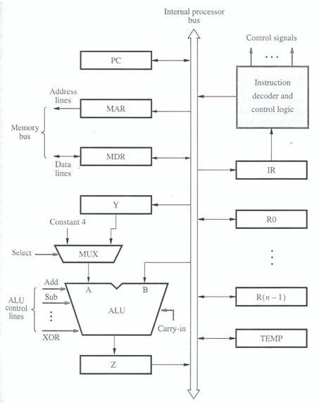
Figure 1: Single-bus Organization of the Data path inside CPU

Slide 6
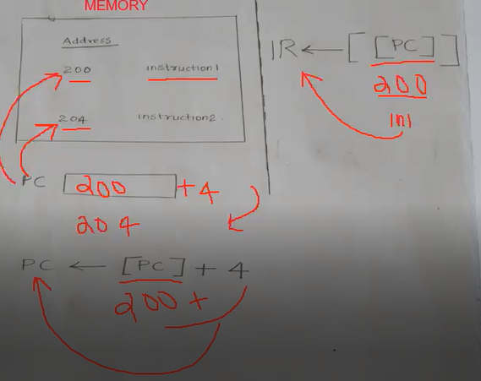

Slide 7
The control lines of the memory bus are connected to the instruction decoder and control logic.
This unit is responsible for issuing the signals that control the operation of all the units inside the processor and for increasing with the memory bus.
The number & use of the processor registers R0 through R(n-1) vary considerably from one processor to another.
These registers may be general purpose registers used by the programmer and special purpose registers dedicated for particular purpose used by the processor, such as index registers or stack pointers, etc.
3 registers Y, Z & TEMP in fig are used by the processor for temporary storage during execution of instruction
The MUX selects either the output of register Y or a constant value 4 to be provided as input A of the ALU.
The constant 4 is used to increment the contents of the program counter.

Slide 8
Executing an Instruction
With few exceptions, an Instruction can performs some operations like:
Transfer a word of data from one processor register to another or to the ALU. (REGISTER TRANSFERS)
Perform arithmetic or a logic operation and store the result in a processor register.(ARITHMETIC OR LOGIC OPERATION)
Fetch the contents of a given memory location and load them into a processor register.(FETCHING)
Store a word of data from a processor register into a given memory location.(STORING)

Slide 9
REGISTER TRANSFERS
Example: MOVE R1, R4
Suppose we wish to transfer the contents of register R1 to register R4. This can be accomplished as follows:
Enable the output of registers R1 by setting R1_{out} to 1. This places the contents of R1 on the processor bus.
Enable the input of register R4 by setting R4_{in} to 1. This loads data from the processor bus into register R4.
CONTROL SEQUENCE
R1_{out}, R4_{in}

Slide 10
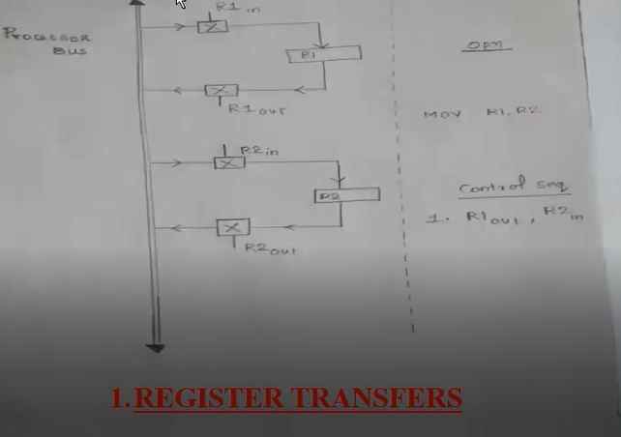

Slide 11
Internal processor
b
us
R
i
in
R
i
R
i
out
Y
in
Y
Constant 4
Select
MUX
A
B
ALU
Z
in
Z
Z
out

Slide 12
Instruction execution involves a sequence of steps in which data are transferred from one register to another.
For each register two control signals are used to place the contents of that register on the bus or to load the data on the bus into register.(symbolically represented in above figure)
The input and output of register R_{i} are connected to the bus via switches controlled by the signals Ri_{in} and Ri_{out} respectively.
When Ri_{in} is set to 1, the data on the bus are loaded into R_{i}.
Similarly, when Ri_{out} is set to 1, the contents of register R_{i} are placed on the bus.

Slide 13
2. PERFORM AN ARITHMETIC OR LOGIC OPERATION
Example: ADD R1, R2, R3
The ALU is a combinational circuit that has no internal storage.
ALU gets the two operands from MUX and bus. The result is temporarily stored in register Z.
The sequence of operations to add the contents of register R1 to those of R2 and store the result in R3 is shown below:
CONTROL SEQUENCE
R1_{out}, Y_{in}
R2_{out}, SelectY, Add, Z_{in}
Z_{out}, R3_{in}

Slide 14
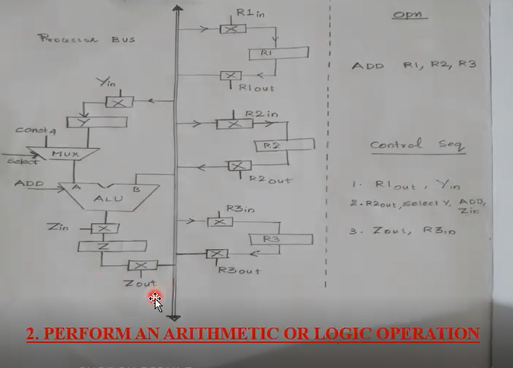

Slide 15
3. FETCHING A WORD FROM MEMORY
Example: Move (R1), R2
The actions needed to execute this instruction are:
MAR ← [R1]
Start a Read operation on the memory bus
Wait for the MFC(Memory Function Completed) response from the memory
Load MDR from the memory bus
R2 ← [MDR]

Slide 16
The connections and control signals for register MDR is shown below:
Figure: Connections for register MDR

Slide 17
CONTROL SEQUENCE
R1_{out}, MAR_{in}, Read
MDR_{inE}, WMFC
MDR_{out}, R2_{in`}

Slide 18
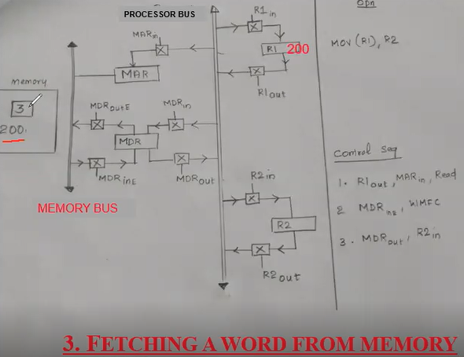

Slide 19
4. STORING A WORD Into MEMORY
Example: Move R2, (R1)
Writing a word into a memory location
follows a similar procedure.
The desired address is loaded into MAR.
Then, the data to be written are loaded
into MDR, and a write command is issued.
CONTROL SEQUENCE
R1_{out}, MAR_{in}
R2_{out}, MDR_{in}, Write
MDR_{outE}, WMFC

Slide 20
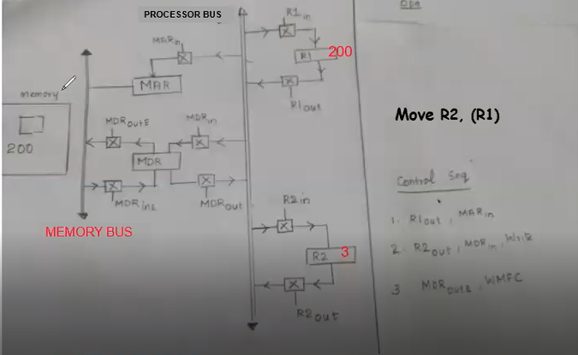
Storing into memory

Slide 21
EXECUTION OF A COMPLETE INSTRUCTION
Let us now put together the sequence of elementary operations required to execute one instruction.
Consider the instruction
ADD (R3), R1
which adds the contents of memory location provided by R3 to register R1. Executing this instruction requires the following actions:
Fetch the instruction.
Fetch the first operand (the contents of the memory location pointed to by R3).
Perform the addition.
Load the result into R1.

Slide 22
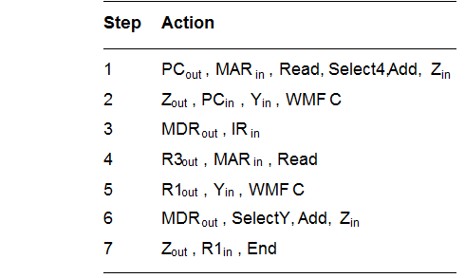
Control Sequence
ADD (R3), R1

Slide 23
Instruction execution proceeds as follows:
FETCH PHASE
In step 1 instruction fetch operation is initiated by loading the contents of the PC into the MAR and sending a read request to the memory.
The select signal is set to select the constant4.
This value is added to the operand at input B, which is the contents of the PC, and the result is stored in register Z.
The updated value is moved from register Z back into the PC during step 2, while waiting for the memory to respond.
In step 3, the word fetched from the memory is loaded into the IR.
Steps 1 to 3 constitute the instruction fetch phase, which is the same for all instructions.

Slide 24
EXECUTE PHASE
The instruction is decoded and the control circuitry activates the control signals for steps 4 through 7, which constitute the execution phase.
The contents of register R3 are transferred to MAR in step 4, and a memory read operation is initiated.
Then the contents of R1 are transferred to register Y in step 5, to prepare for the addition operation.
When the read operation is completed, the memory operand is available in register MDR, and the addition operation is performed in step 6.
The addition is performed by ALU and the sum is stored in register Z, and then transferred to R1 in step 7.
The END signal causes a new instruction fetch cycle to begin by returning to step 1.

Slide 25
NOTE
This discussion accounts for all control signals in figure5 except Y_{in} in step 2. There is no need to copy the updated contents of PC into register Y when executing the Add instruction. But, in branch instructions the updated value of the PC is needed to compute the branch target address. To speed up the execution of branch instructions, this value is copied into register Y in step 2.

Slide 26
MULTIPLE-BUS ORGANIZATION
We used the simple single-bus architecture of figure 1 to illustrate the basic ideas.
The resulting control sequences in figure 5 and 6 are quite long because only one data item can be transferred over the bus in a clock cycle.
To reduce the number of steps needed, most commercial processors provide multiple internal paths that enable several transfers to take place in parallel.

Slide 27
Figure:
Three-bus organization of the data path

Slide 28
MULTIPLE-BUS ORGANIZATION
Figure above depicts a three-bus structure used to connect the registers and ALU of a processor.
All general purpose registers are combined into a single block called the register file.
The register file in figure 7 is said to have three ports. There are two outputs, allowing the contents of two different registers to be accessed simultaneously and have their contents placed on buses A and B. The third port allows the data on bus C to be loaded into a third register during the same clock cycle.
Buses A and B are used to transfer the source operands to the A and B inputs of the ALU, where an arithmetic or logic operations may be performed.
The result is transferred to the destination over bus C.

Slide 29
Cntd…
If needed, the ALU may simply pass one of its two input operands unmodified to bus C. We will call the ALU control signals for such an operation R=A or R=B.
Another feature in figure 7 is the introduction of the Incrementer unit, which is used to increment the PC by 4.
Using the Incrementer eliminates the need to add 4 to the PC using the main ALU.
The source for the constant 4 at the ALU input multiplexer is still useful. It can be used to increment other addresses such as the memory addresses in load multiple and store multiple instructions.

Slide 30
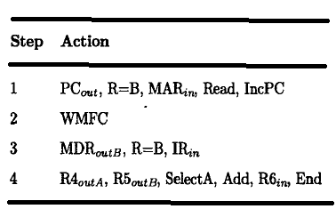
Control Sequence
//PC to MAR through i/p B of ALU
//Wait for MEM function to complete
//MDR to IR through input B of ALU
Figure : Control sequence for Add R4, R5, R6 using three bus organization

Slide 31
Consider the three operand instruction
ADD R4, R5, R6
The control sequence for executing this instruction is given in figure 8.
In step 1, the contents of the PC are passed through the ALU, using the R=B control signal, and loaded into the MAR to start a memory read operation. (PC to MAR)
At the same time the PC is incremented by 4.
In step 2, the processor waits for MFC (MEMORY FUNCTION COMPLETE) and loads the data received into MDR.
transfers data from MDR to IR in step 3.
Finally, the execution phase of the instruction requires only one control step to complete, step 4.
By providing more paths for data transfer a significant reduction in the number of clock cycles needed to execute an instruction is achieved.

Slide 32
END of Module 4 Part A: BPU

Slide 33
PRESIDENCY UNIVERISTY, BENGALURU, School of Engineering
Computer Organization and Architecture
CSE 2009
Module-4: Part B-Pipelining

Slide 34
MODULE 4B. Pipelining
Pipelining is widely used in modern processors.
Pipelining improves system performance in terms of throughput.
Pipelined organization requires sophisticated compilation techniques.

Slide 35
Making the Execution of Programs Faster
Basic Concepts
Use faster circuit technology to build the processor and the main memory.
Arrange the hardware so that more than one operation can be performed at the same time.
In the latter way, the number of operations performed per second is increased even though the elapsed time needed to perform any one operation is not changed.

Slide 36
Traditional Pipeline Concept
Laundry Example
Ann, Brian, Cathy, Dave each have one load of clothes to wash, dry, and fold
Washer takes 30 minutes
Dryer takes 40 minutes
“Folder” takes 20 minutes
A
B
C
D

Slide 37
Traditional Pipeline Concept
6 PM
7
8
9
10
11
Midnight
Time
30
40
20
30
40
20
30
40
20
30
40
20
Sequential laundry takes 6 hours for 4 loads
If they learned pipelining, how long would laundry take?
A
B
C
D

Slide 38
Traditional Pipeline Concept
6 PM
7
8
9
10
11
Midnight
T
a
s
k
O
r
d
e
r
Time
30
40
40
40
40
20
A
Pipelined laundry takes 3.5 hours for 4 loads
B
C
D

Slide 39
Traditional Pipeline Concept
Pipelining doesn’t help latency of single task, it helps throughput of entire workload
Pipeline rate limited by slowest pipeline stage
Multiple tasks operating simultaneously using different resources
Potential speedup = Number pipe stages
Unbalanced lengths of pipe stages reduces speedup
Time to “fill” pipeline and time to “drain” it reduces speedup
Stall for Dependences (stall is a delay in execution of an instruction in order to resolve a hazard.)
6 PM
7
8
9
Time
T
a
s
k
O
r
d
e
r
30
40
40
40
40
20
A
B
C
D

Slide 40
Use the Idea of Pipelining in a Computer
Fetch + Execution
T
ime
I
1
I
2
I
3
T
ime
Clock cycle
1
2
3
4
F
1
E
1
F
2
E
2
F
3
E
3
Instruction
(a) Sequential execution
I
1
F
1
E
1
I
2
F
2
E
2
Interstage buffer
B1
I
3
F
3
E
3
Instruction
Ex
ecution
fetch
unit
(c) Pipelined execution
unit
(b) Hardware organization
Figure 8.1. Basic idea of instruction pipelining.

Slide 41
Use the Idea of Pipelining in a Computer
Fetch + Decode
+ Execution + Write
Textbook page: 457

Slide 42
Role of Cache Memory
Each pipeline stage is expected to complete in one clock cycle.
The clock period should be long enough to let the slowest pipeline stage to complete.
Faster stages can only wait for the slowest one to complete.
Since main memory is very slow compared to the execution, if each instruction needs to be fetched from main memory, pipeline is almost useless.
Fortunately, we have cache.

Slide 43
Pipeline Performance
The potential increase in performance resulting from pipelining is proportional to the number of pipeline stages.
However, this increase would be achieved only if all pipeline stages require the same time to complete, and there is no interruption throughout program execution.
Unfortunately, this is not true.

Slide 44
Pipeline Performance

Slide 45
Pipeline Performance
The previous pipeline is said to have been stalled for two clock cycles.
Any condition that causes a pipeline to stall is called a hazard.
Data hazard – any condition in which either the source or the destination operands of an instruction are not available at the time expected in the pipeline. So some operation has to be delayed, and the pipeline stalls.
Instruction (control) hazard – a delay in the availability of an instruction causes the pipeline to stall.
Structural hazard – the situation when two instructions require the use of a given hardware resource at the same time.

Slide 46
Pipeline Performance
Instruction hazard
Idle periods – stalls (bubbles)

Slide 47
Pipeline Performance
Structural hazard
Load X(R1), R2

Slide 48
Pipeline Performance
Again, pipelining does not result in individual instructions being executed faster; rather, it is the throughput that increases.
Throughput is measured by the rate at which instruction execution is completed.
Pipeline stall causes degradation in pipeline performance.
We need to identify all hazards that may cause the pipeline to stall and to find ways to minimize their impact.

Slide 49
Quiz
Four instructions, the I2 takes two clock cycles for execution. Pls draw the figure for 4-stage pipeline, and figure out the total cycles needed for the four instructions to complete.

Slide 50
END of Module 4 Part B: Pipelining

